Slide 1
Design for Verification Project Update
2021-06-30
Eldrick Millares, Jack Humphries (eldrick, jhumphri@stanford.edu)

Slide 2
Recap:
Deploying “External QED” to Steelcore
Running initial tests with control flow
Started deploying on CVA6 (Ariane)
Found the extremal bug generator script

Slide 3
External QED - Progress
Implemented “memory shim” and integrated into design
No control flow - only arithmetic, memory load/store
Changes from original QED so far:
Instantiated separate instruction memory
Added in initial “boot address” constraint for PC
Extended Tc later to account for initial fetch cycles, longer pipeline

Slide 4
External QED - Issues
Implementation still ongoing
Current Issues:
Duplicate instructions not being issued
Much longer proof bounds
Previous: Hours for 3-6 instructions
External QED: Jumps from 4 to 16 to 18 within minutes

Slide 5
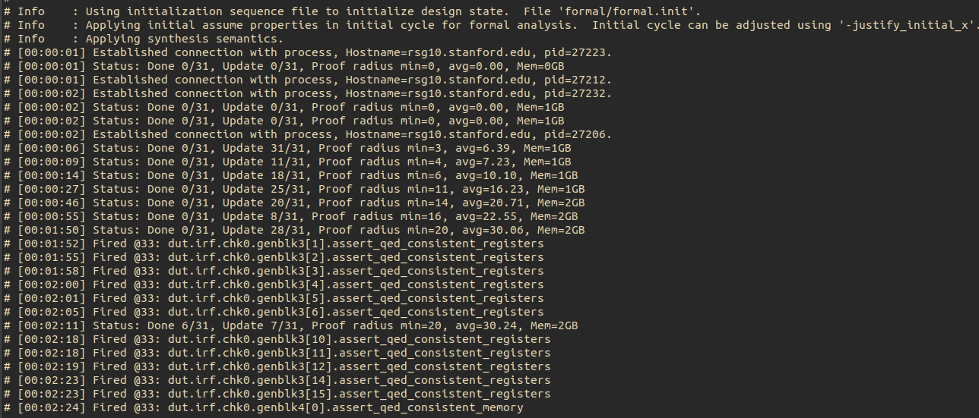
External QED - Proof Radius Issue

Slide 6
Control Flow
Jack pushed his modifications to sqed-generator that includes jump instructions
Need to clean up some small syntax errors from generator

Slide 7
CVA6
Started deploying to CVA6
6 Stage pipeline, System Verilog, capable of booting Linux
More complex ISA (RV64IMAC), more complex uarch
3rd most popular RISC-V core by # of Github Stars

Slide 8
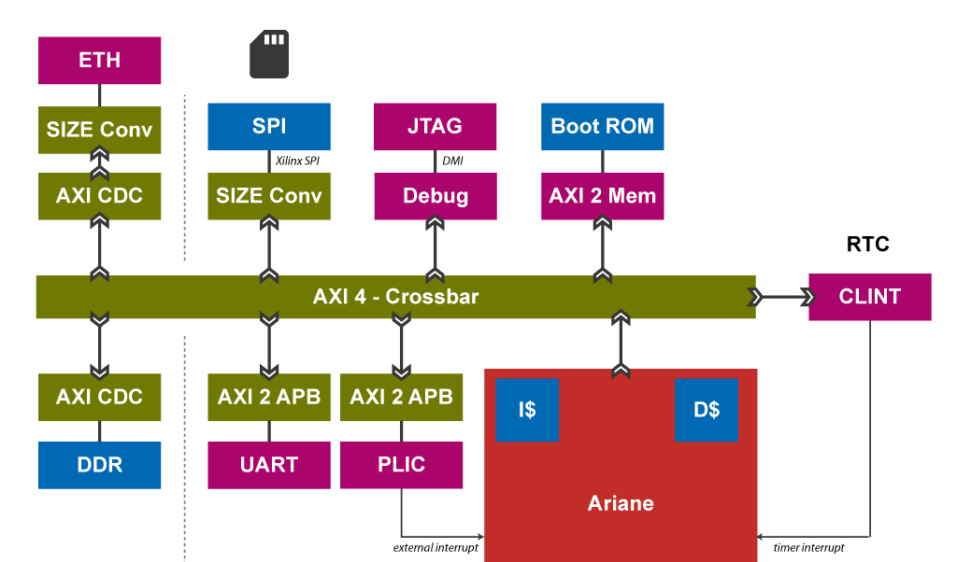
CVA6
Currently trying to figure out how to structure top level
All memory, peripherals connected via AXI interface

Slide 9
Extremal Bug Script
Located in /scratch0/nuthakki/ridecore-master/ridecore-master/src/ride-with-2QED-sss/logic-results-ride-with-2QED-sss-withlw-srcforw/sim_logic_bugs/results-100-rand-indsim-sim-priority/sim_projects-144481-1
Found scripts related to launching simulation, saving state at some point in time, etc
Thank you to Florian for following up with Eshan

Slide 10
Per Week Summer Schedule
Jun 28 Add Control Flow Instrs. to Steel
Jul 05 Basic External QED on Steel
Jul 12 ...
Jul 19 Finish Deploying on CVA6

Slide 11
Summer Workload
May need to step back summer commitment
Excited about project, plan on developing in free time
Am planning on taking only research units in Fall

